Slide 1
Lending Club Case Study
Team:
Nishant Mundhra
Indu Mary Philip

Slide 2
Objective
The Objective of this case study is to implement EDA technique on a real-world problem and understand the insights and present in a business first manner via presentation.
Benefits of the case study:
Gives an idea about how EDA is used in real life business problems.
It also develops a basic understanding of risk analytics in banking and financial services.
How the data is used to minimize loss of money while lending it to clients.
It improves our understating of visualization and what charts to use for real life data.

Slide 3
Business Understanding
The business objective is to take a decision whenever they receive a loan application whether to reject or approve based on certain variables.
Dataset Details:
The data given below contains information about past loan applicants and whether they ‘defaulted’ or not. Data has details regarding approved loan not the rejected ones. It has 3 status of loan which is Fully Paid, Current and Charged-Off.
Data Clean-up and preparation process:
Importing the Data
Removing large null value columns
Removing irrelevant columns
Removing/Fixing null values
Correcting data types and deriving new columns
Filter Data for requirement.
Removing Duplicate Data
Removing outliers

Slide 4
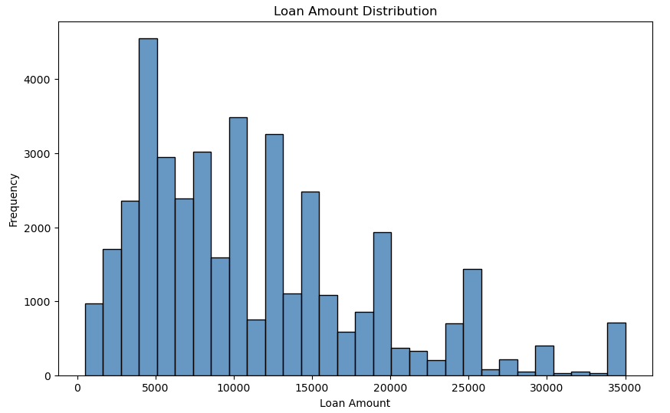
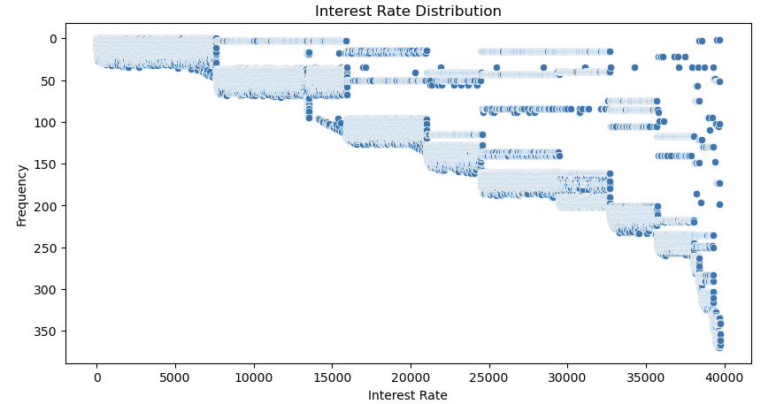
Loan Amount and Interest Rates
Interest Rate: Interest Rate on the loan.
It can be clearly observed that
lower the interest rate, higher the frequency
&
higher the interest rate, lower the frequency
Loan Amount: The listed amount of the loan applied by the borrower.
Frequency is found to be maximum for Loan amount 5K.
Frequency of more than 3K is found across loan amount between 10K and 15K

Slide 5
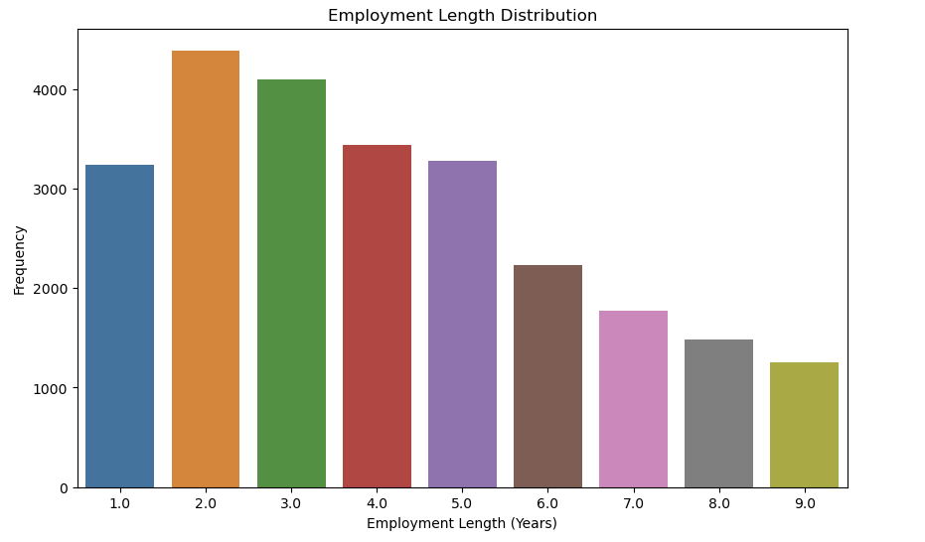
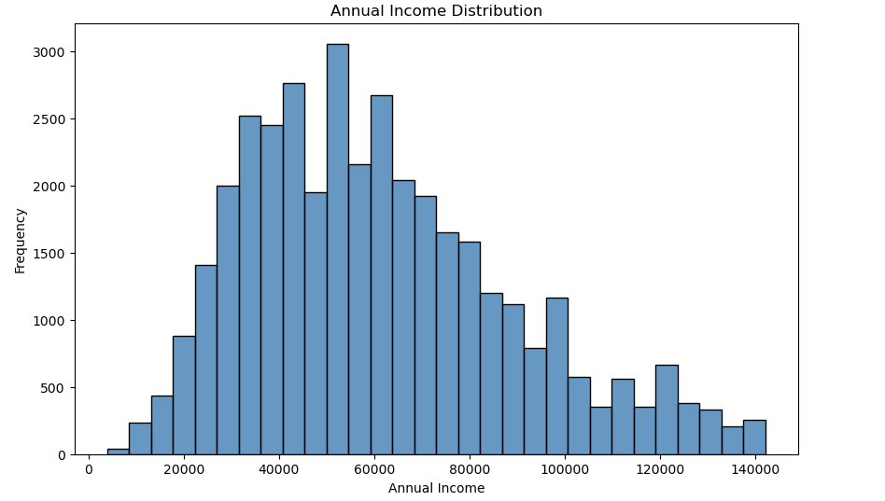
Employment Length & Annual Income
Employment Length: Employment length in years.
New Employees within 3 years of joining tend to frequent the loan requests
Annual Income: Self reported annual income reported by borrower during registration.
Mid range of Annual income varying from 40K to 70K tend to frequent the loan requests

Slide 6
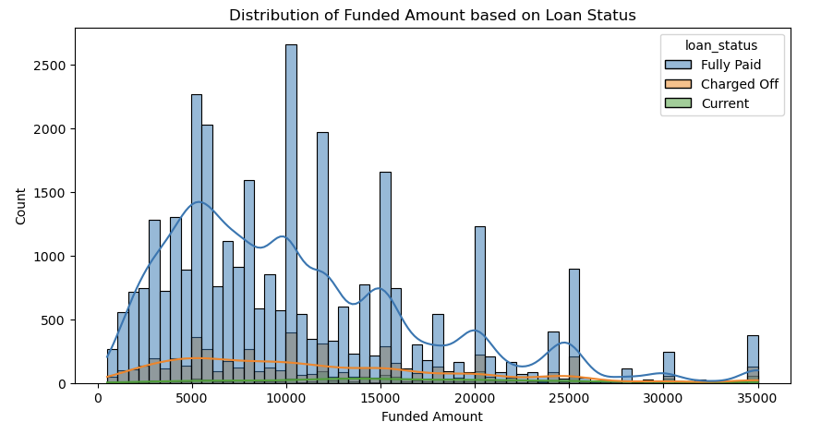
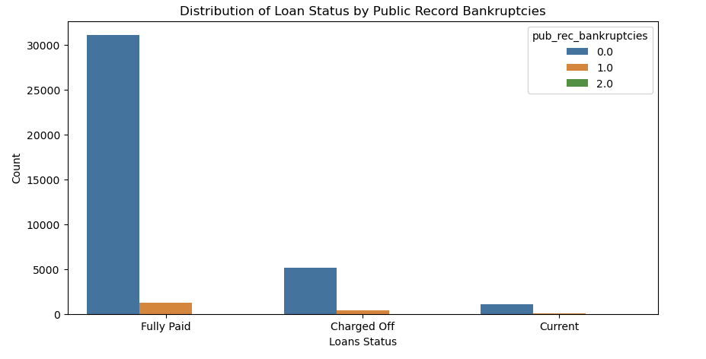
Funded Amount & Public Rec Bankruptcies
Funded Amount: Total amount committed to the loan at a point in time.
The higher the Funded Amount, better the loan status
Public Rec Bankruptcies: No of Public Record Bankruptcies
Majority of clients have no record of declaring bankruptcy.

Slide 7
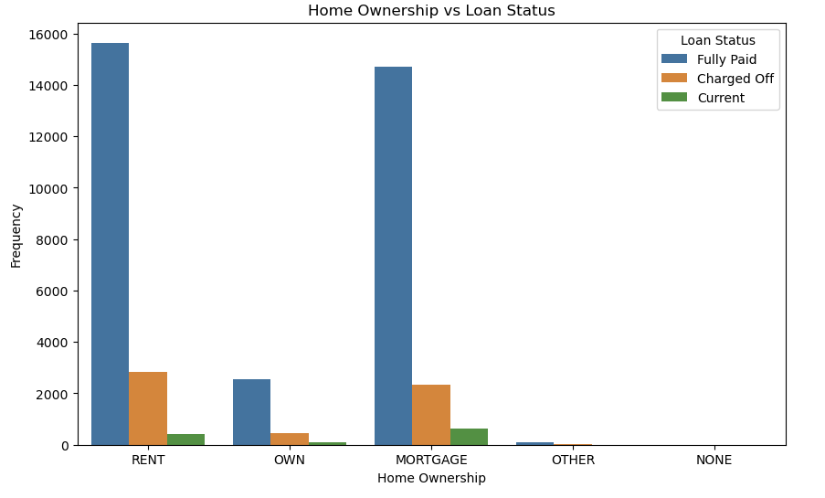
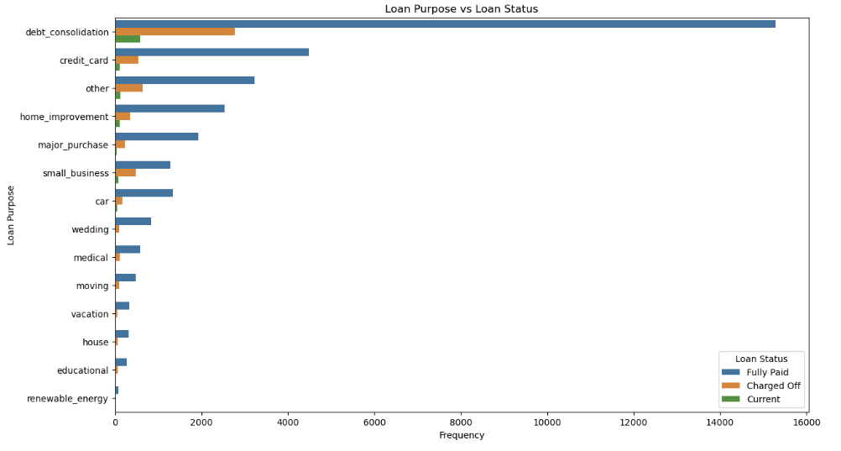
Home Ownership & Loan Purpose
Home Ownership: Majority of clients are lacking ownership of any property and are on rent or mortgage and have a higher chance of defaulting.
Purpose: Loans are taken mostly for debt consolidation followed by credit card payment. Whereas the debt consolidation has highest fully paid loan but also has highest defaulted loans as well.

Slide 8
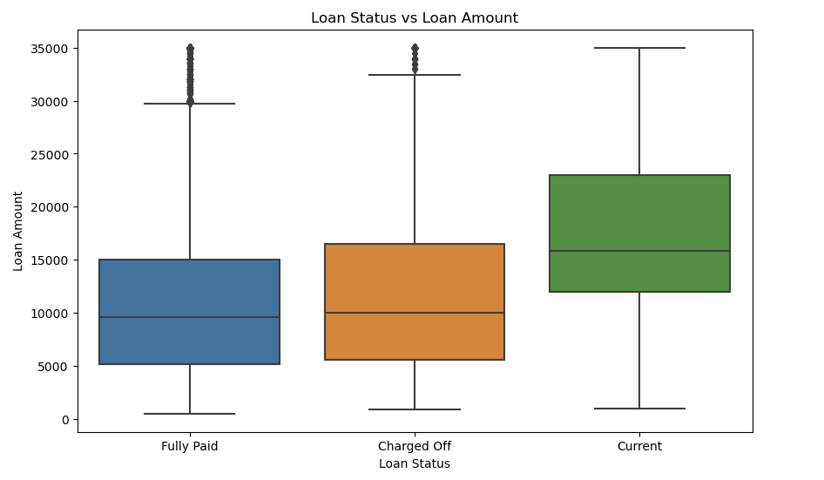
Loan Status vs Loan Amount
Currently there are no high Loan Amount outliers
Most of the high loan Amount are fully paid
Defaulters have high loan amount which needs to be followed up on closely

Slide 9
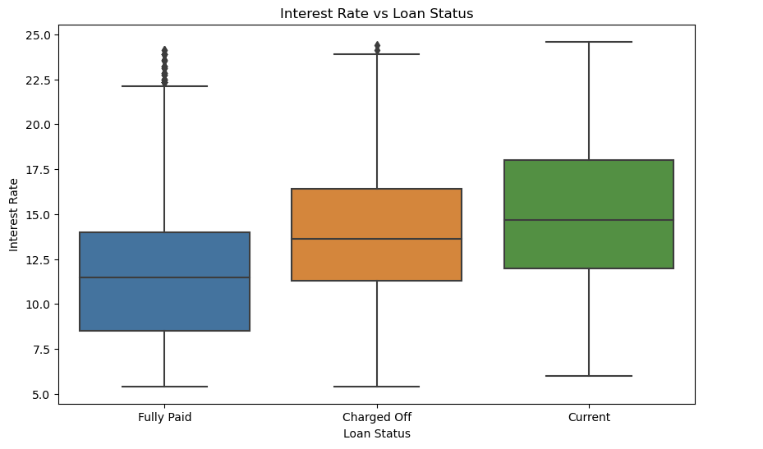
Interest Rates Vs Loan Status
There are no outliers in current status with respect to higher interest rates.
Most of the high interest rate loans are fully paid
Defaulters also have interest rate Loans which need to be monitored and followed up promptly

Slide 10
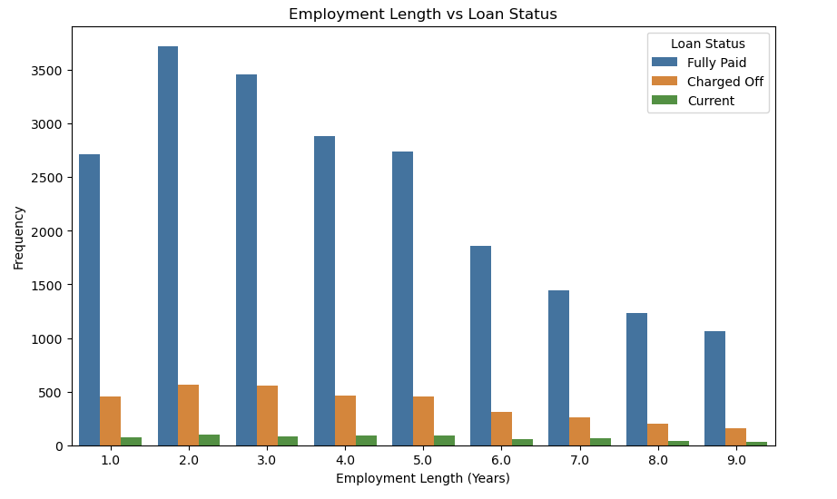
Employment Length Vs Loan Status
It can be clearly understood that across all the Employment tenure buckets most of the loans are fully paid.
The trend of Defaulters and current keep decreasing as the tenure increases

Slide 11
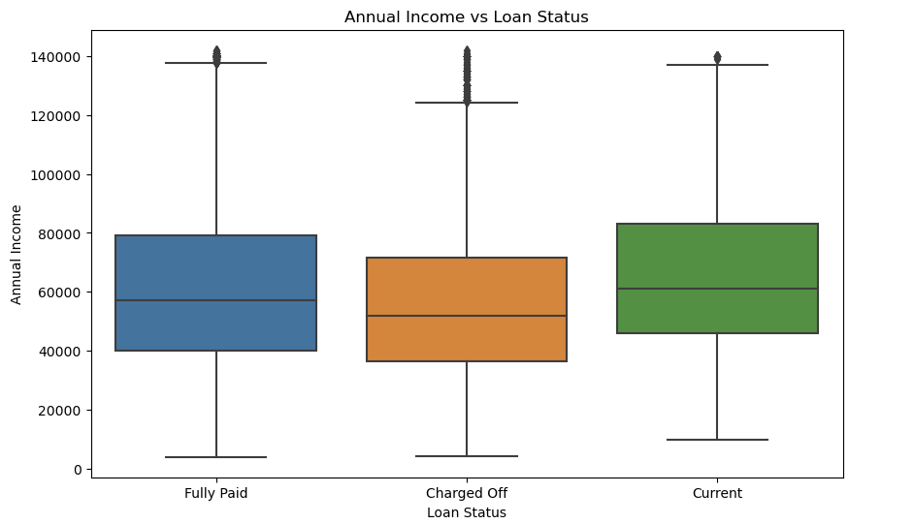
Annual Income Vs Loan Status
The mid band is consistent with their loan payment patterns.
There are many high-income employees that are defaulters.

Slide 12
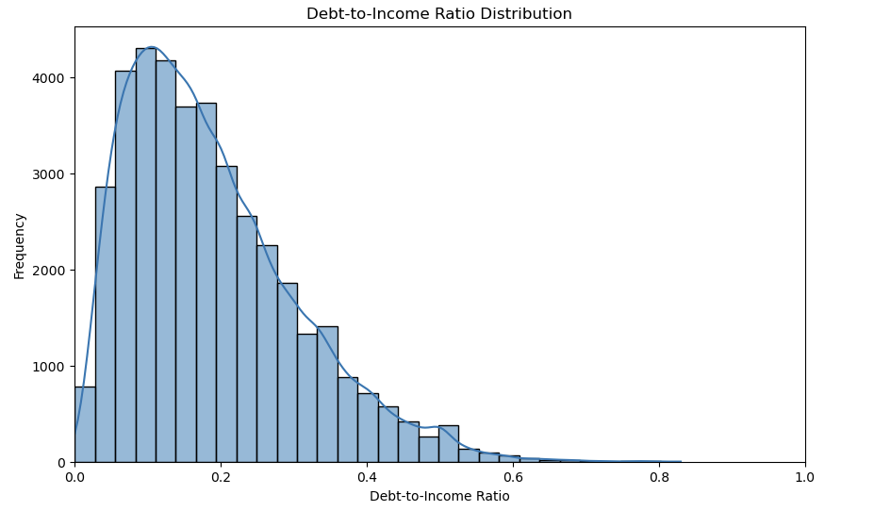
Debt-to-income
Your debt-to-income ratio (DTI) is all your monthly debt payments divided by your gross monthly income. This number is one way lenders measure your ability to manage the monthly payments to repay the money you plan to borrow.
Frequency is highest across DTI ratio from 0.1 to 0.2 which is favorable

Slide 13
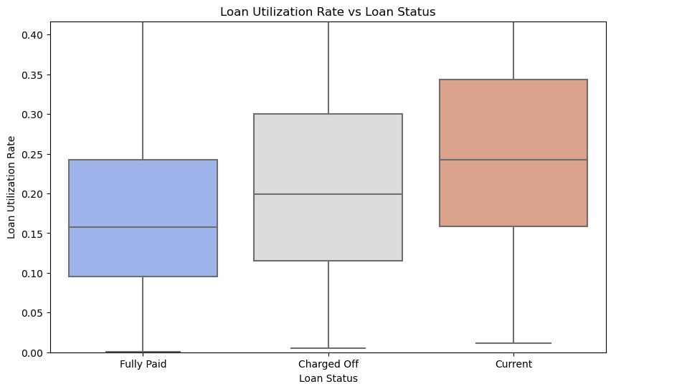
Loan Utilization Rate
Total Utilization of Revolving Loan Commitments means, as at any date of determination, the sum of (i) the aggregate principal amount of all outstanding Revolving Loans plus (ii) the aggregate principal amount of all outstanding Swing Line Loans plus (iii) the Letter of Credit Usage.
The currently unpaid loans needs to be closely monitored as the Loan Utilization Rate seems to be weighing high

Slide 14
Recommendations
Recommendations
Major Driving factor which can be used to predict the chance of defaulting and avoiding Credit Loss:
1. DTI
2. Annual income
3. Interest Rates

Slide 15
Recommendations
Recommendations
Major Driving factor which can be used to predict the chance of defaulting and avoiding Credit Loss:
DTI
Loan Utilisation Rate
Annual income
Interest Rates
Other considerations for 'defaults’ :
Borrowers having annual income in the range 50000-100000.
Borrowers having Public Recorded Bankruptcy.
Borrowers with very high Debt to Income value.
Borrowers with working experience 10+ years.

